Slide 1

IBM SkillsBuild 6 Internship for Emerging Technologies
Submitted By:-
Name : Amrit Singh
Semester : 7th
Roll no : 20010581
Branch : Computer Engineering
PRESENTATION ON INDUSTRIAL TRAINING AND INTERNSHIP

Slide 2
TABLE OF CONTENTS
#1
ABOUT THE COMPANY
#4
INTERNSHIP TRAINING and TECHNOLOGIES
#2
DURATION Of INTERNSHIP
#5
PROJECT DETAILS
#3
WEEKLY TRAINING INFORMATION
#6
INTERNSHIP CERTIFICATE

Slide 3
ABOUT THE COMPANY :
IBM is one of the world's largest and oldest technology companies, with a focus on providing a wide range of hardware, software, and services.
IBM is known for its contributions to the development of computers and information technology. This is a virtual internship provided by IBM through its IBM SkillsBuild platform. The IBM SkillsBuild project-based internship on IR 4.0 technologies are for 6-weeks, wherein students will work to solve real-world challenges and create solutions that will give them hands-on experience critical for future employability.
The program was brought to me by Edu net Foundation in partnership with AICTE (All India Council for Technical Education)

Slide 4
DURATION Of INTERNSHIP
Program Title :
Program Duration :
IBM Skills Build 6 Weeks Internship for Emerging Technologies in Data Analytics (DA)
6 Weeks
Start Date: 12th June,2023 End Date: 24th July,2023

Slide 5
WEEKLY TRAINING INFORMATION
Week 1
Week 2
Week 4
Week 3
Week 6
Week 5
Learning Plan II (Python for Data Science and Data Analysis with python)
Orientation , Learning Plan I (Introduction to Data Concepts, Data science in analysis and Data tools)
Instruction for Project: Case Study (Superstore analysis)
Learning Plan III (Big Data Foundation and Exploratory Data analysis)
Instructions for Data Visualization.
Instruction for data pre-processing and cleaning
Week 7
Submission of the Project – Case Study: Superstore Analysis.

Slide 6
INTERNSHIP TRAINING and TECHNOLOGIES
Technology Tracks
Define Problems :- Clearly outline analysis objectives and questions.
Import Libraries :- Use Python or R with libraries like Pandas, NumPy for data manipulation.
Import Dataset :- Load data using language-specific functions or tools.
Clean Data - Pre-Process :- Identify and handle missing data, outliers using Pandas or Scikit-Learn.
Summarize Dataset :- Utilize Pandas and NumPy for descriptive stats and exploratory analysis.
Visualize Data :- Create plots and charts with Matplotlib, Seaborn, or Plotly.
Conclusion :- Summarize insights, linking back to defined problems.
Tools Used:
Python : Versatile programming language for data analysis.
Pandas : Python library for efficient data manipulation and analysis.
NumPy : Fundamental package for scientific computing in Python.
Matplotlib : 2D plotting library for creating visualizations.
Seaborn : Statistical data visualization library built on Matplotlib.

Slide 7
PROJECT DETAILS
Define the problems
This project analyses a dataset of sales data from a fictional superstore. The goal of the project is to identify trends and patterns in the data that can help the superstore improve its business performance.
Project overview
Agenda:
• Perform exploratory data analysis (EDA) to gain insights into the data.
• Develop recommendations for the superstore to improve its business performance.
• Increasing sales of high-margin products Targeting its marketing efforts to specific customer segments.
• Identify trends and patterns in the data that can help the superstore improve its business performance.
Conclusion
This project aimed to analyze a sales dataset from a fictional superstore to uncover trends and patterns for improving business performance. The process involved conducting Exploratory Data Analysis (EDA), cleaning and pre-processing data, and summarizing key insights.

Slide 8
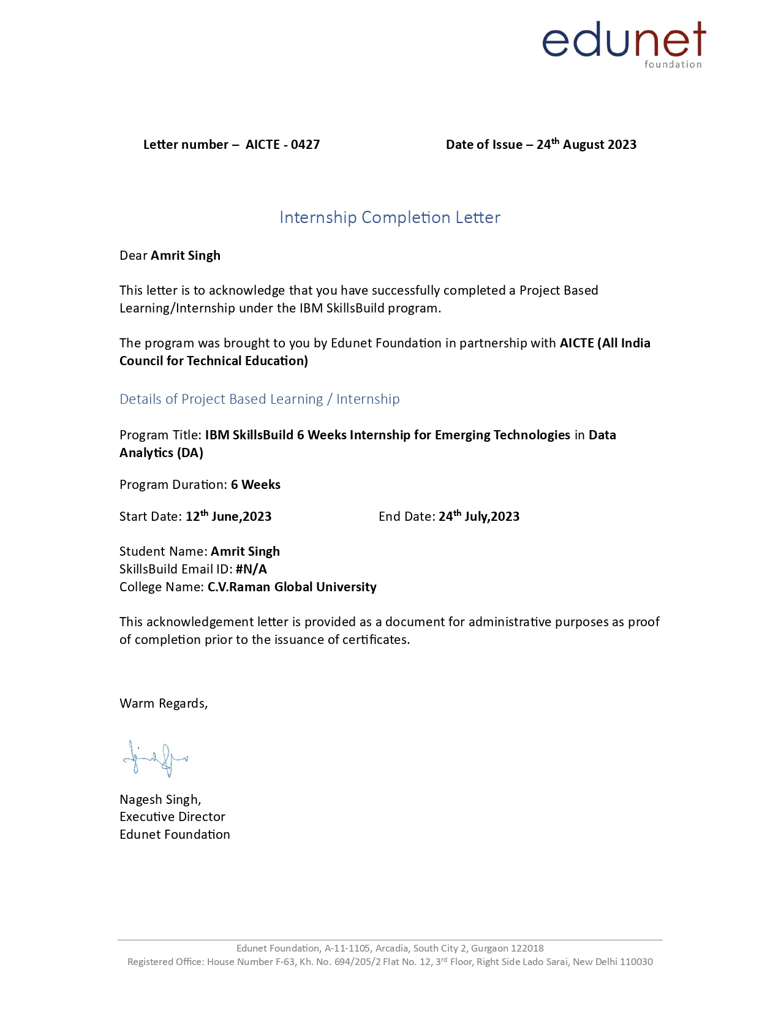
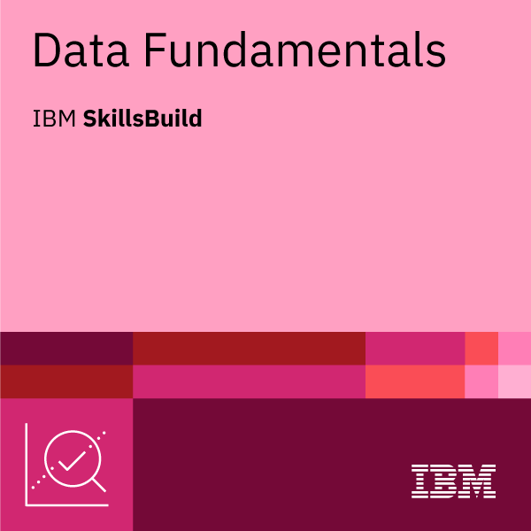
This credential earner demonstrates knowledge of data analytics concepts, methodologies and applications of data science, and the tools and programming languages used in the data ecosystem. The individual has a conceptual understanding of how to clean, refine, and visualize data using IBM Watson Studio. The earner is aware of the job outlook in data and is familiar with the skills required for success in various roles in the domain.
INTERNSHIP CERTIFICATE

Slide 9
CONCLUSION :
Through this internship under the IBM SkillsBuild program, I gained invaluable hands-on experience and deepened my understanding of Data Analytics (DA) .
I developed strong skills in statistical analysis, programming (Python), and database manipulation (SQL). Key skills include data visualization, cleaning, and preprocessing.
Continuous learning and practical experience through real-world projects enhance expertise in this dynamic field.
I am grateful to IBM SkillsBuild program for providing me with this enriching learning opportunity and look forward to utilizing my acquired knowledge.
I am confident that I have acquired valuable skills and knowledge to contribute meaningfully to the field of Data Analytics (DA) and pursue a successful career.

